Slide 1



HOSTS
OFFICIAL CARRIER

Slide 2
The Growth of China in Africa
Route Development with Gulf and Chinese Carriers
30th May, 2010

Slide 3
ASM Introduction
ASM is the World’s leading route development company.
We work only for airports and have a global reach.
ASM has offices supporting route development in Manchester, Warsaw, Sofia, Dubai, Mexico, Kuala Lumpur, Beijing and Wellington, New Zealand.
We understand what airlines want and what airports should be doing to develop their airline networks.
I hope you find this afternoon’s workshop useful and productive.
3

Slide 4
What Drives China-Africa
Route Development?

Slide 5
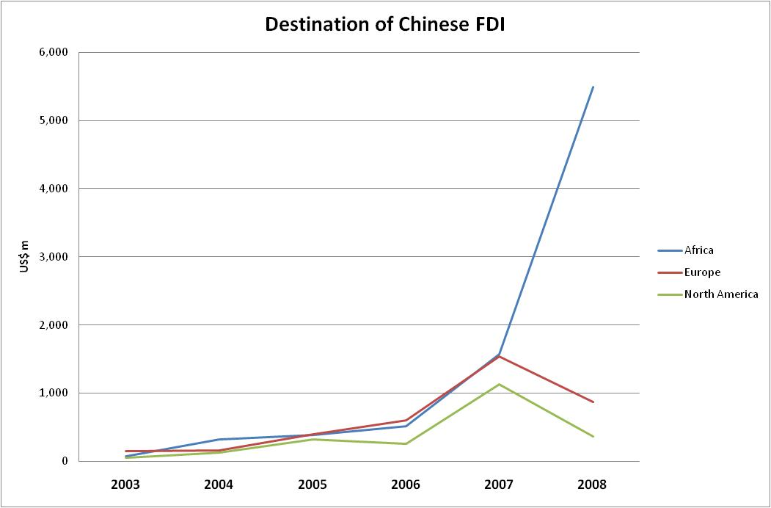
Trade and Investment is driving passenger expansion
Chinese investment volumes have rocketed in Africa from 2007. Prior to that, Chinese investment ran at similar levels to investment in Europe and North America.
5

Slide 6
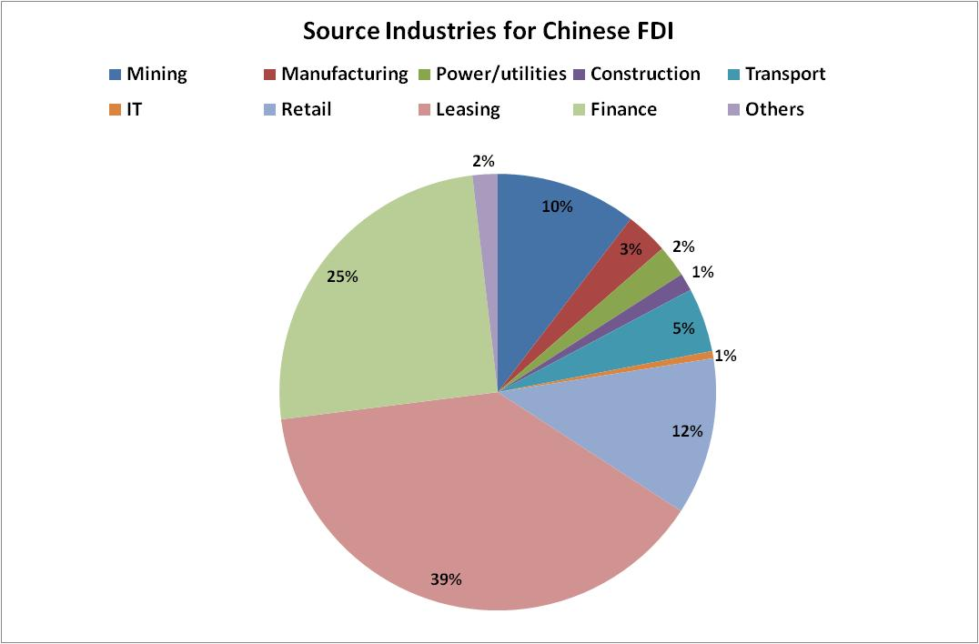
Trade and Investment is driving passenger expansion
It’s more about financing
the deal than making things
The largest sectors of outbound Chinese FDI focuses upon leasing facilities, infrastructure and the access to finance required. Direct investment in manufacturing, mining or construction are much smaller than these two main export segments.
6

Slide 7
Who provides the export drive?
This is a list of the top 20 Chinese exporters and overseas investors:
China National Petroleum
China Petro-Chemical Corp
Aluminium Corp of China
China Resources Holding
China Ocean Shipping Group
China National Offshore Oil
China National Cereals, Oils and Foodstuffs
Sino-Chem
CITIC
China Merchants Group
Sino Steel Corp
China Shipping Group
China National Aviation
China MinMetals
China National Chemical Corp
China State Construction
China Mobile Communications
China Huaneng
China Unicom
Sum Yip Holdings
7

Slide 8
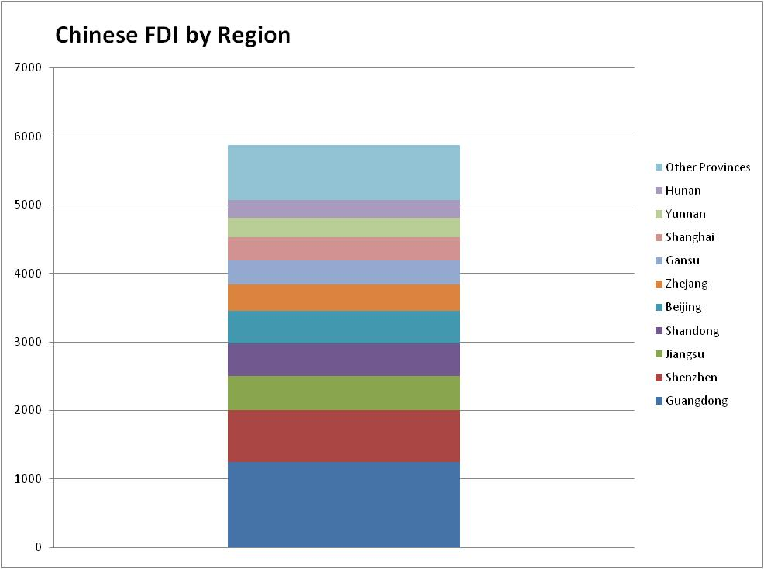
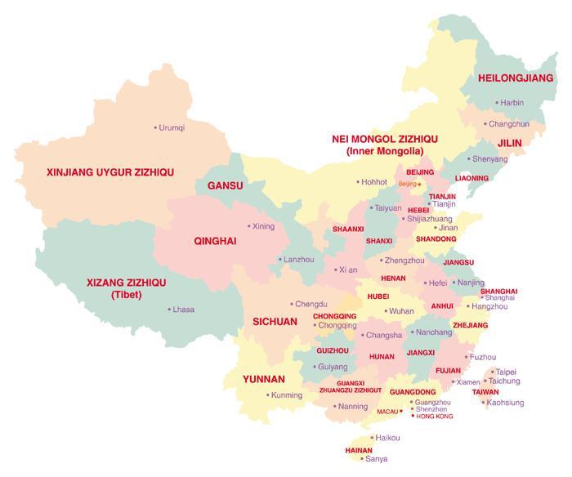
Where is the traffic coming from?
The Pearl River Delta generates about a third of all Chinese exports to Africa.
50% of all trade comes from two regions; the Pearl River and around Shanghai.
Most activity emerges from coastal cities.
90%+ of trade activity comes from 10 Provinces.
8

Slide 9
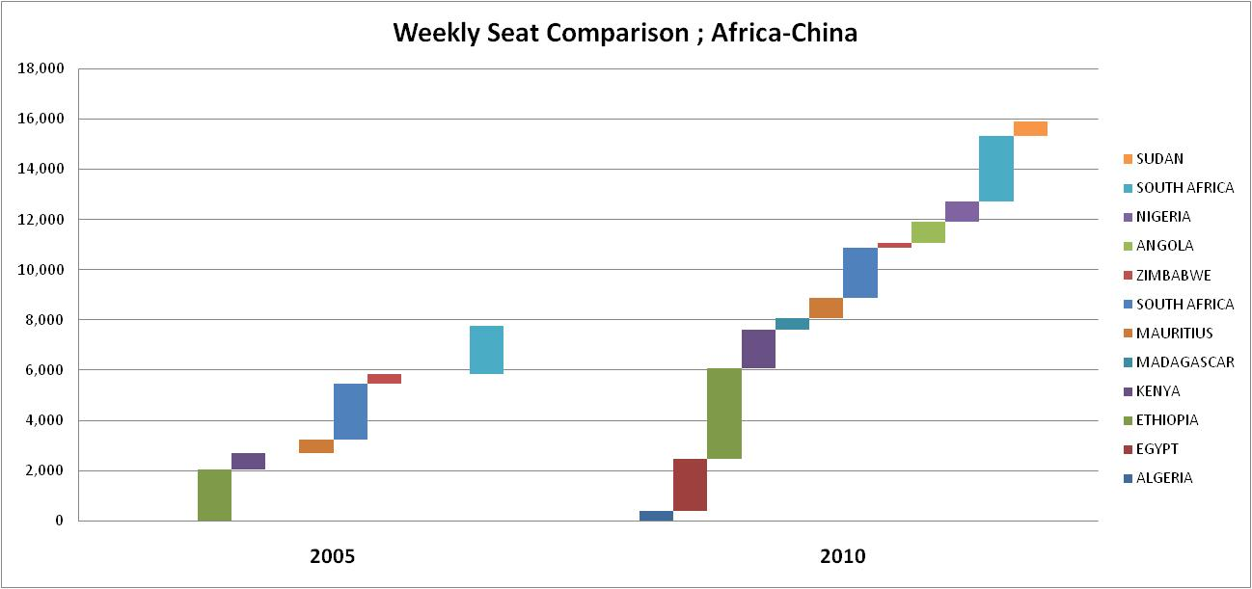
Air Service Development
There were only 6 countries with direct services to China from Africa (including the Maghreb) in 2005.
There are now double country-pair services operated by either African or Chinese carriers.
Weekly seats have risen from 7,700 to 16,000 weekly seats.
This excludes the connecting permutations via the Gulf, Turkey or Asia.
(Data source: FlightBase)
9

Slide 10
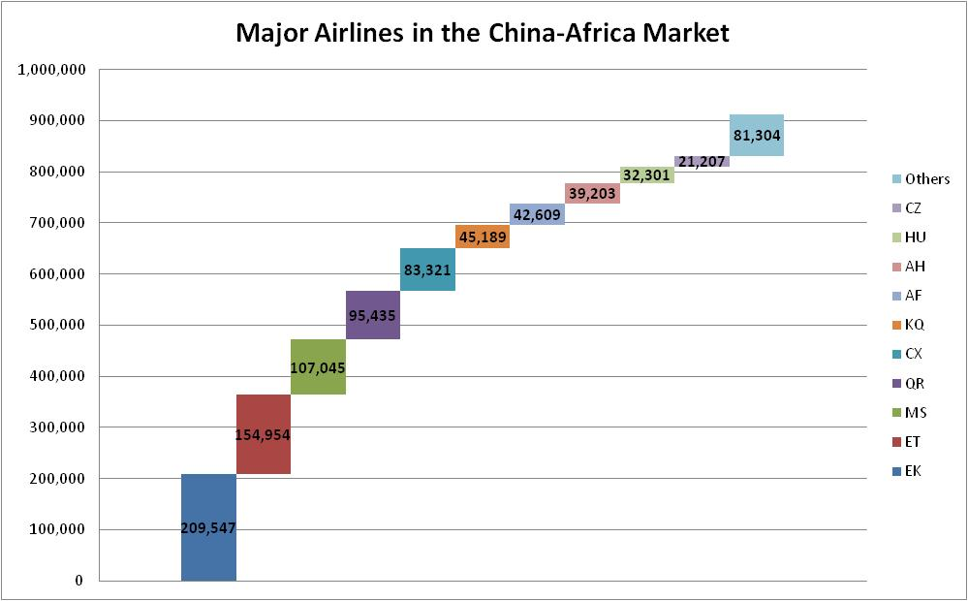
Who is Enjoying the Chinese Buffet?
(Data source: IATA AirportIS)
Approximately 912,000 passengers travelled between China and Africa in the 12 months up to March 2010.
This traffic serves as a wonderful source of new business for the Gulf carriers.
EK and QR have managed to grab about 30% of this market. Note the importance of the China market to ET.
Ten airlines accounted for 91% of the market
10

Slide 11
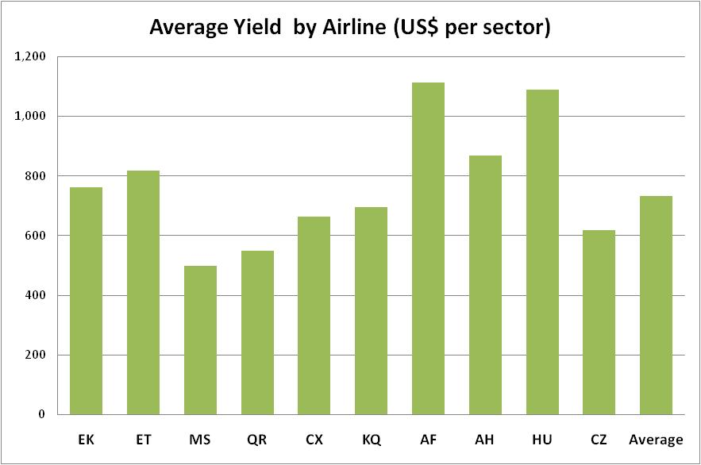
City-Pair Market Sizes
(Data source: IATA AirportIS)
The highest yield between Africa and China is being extracted by Air France.
Some of the lowest yields are being offered by the Gulf carriers and Egyptair.
Africa-China represents a $160m market for EK, and $127m for ET.
11

Slide 12
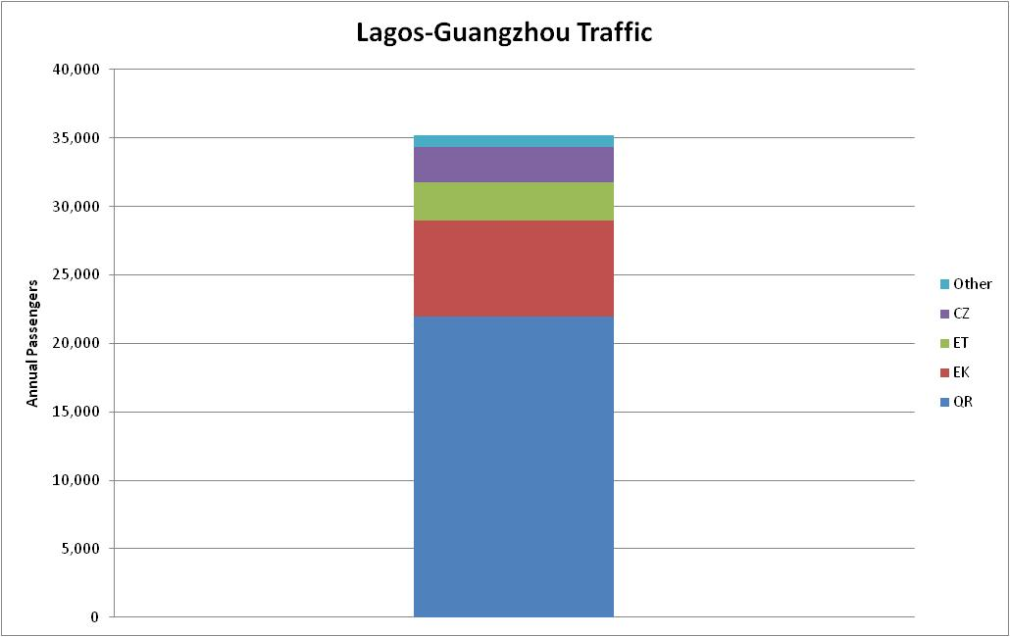
Example City-Pair Market Size
(Data source: IATA AirportIS)
The LOS-CAN route produces 35,000 passengers from April 2009 to march 2010.
QR clearly wins in this market, with EK next. ET is third and all other airlines constitute less than 1% of traffic.
12

Slide 13
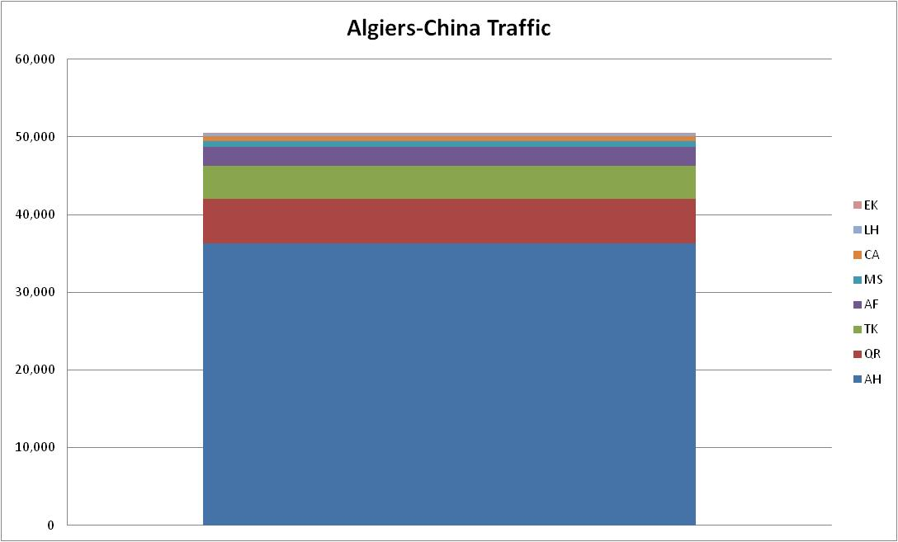
Example City-Pair Market Size
(Data source: IATA AirportIS)
Air Algerie manages to secure about 75% of the total market to China.
Qatar is the second busiest airline, but Emirates attracts a very small market.
Note the presence of Turkish Airlines – an airline that has aggressive Asian plans in the near future.
13

Slide 14
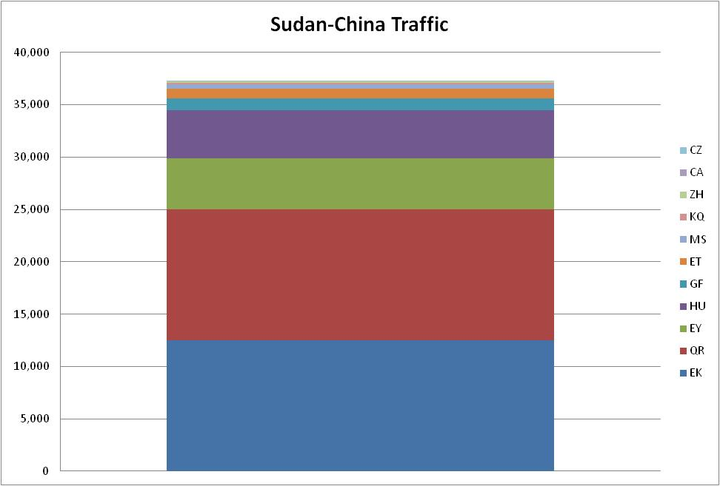
Example City-Pair Market Size
(Data source: IATA AirportIS)
Sudan is another expanding market for carriers operating to China. Because the national airline in Sudan does not have the aircraft to operate to China, the three Gulf carriers pick up almost 80% of this market.
14

Slide 15
Conclusions
Africa-China is one of the few expanding markets.
It provides a rich source of traffic for 6th freedom carriers.
Particularly in markets where the local carrier is weak or operates a small fleet
Africa-China is attractive to Gulf carriers.
It has replaced Europe-Asia traffic affected by the GFC
It is also very important to Ethiopian and Turkish Airlines
All carriers in this market (EK, QR, EY, ET, TK) have aircraft on order – presumably to capitalise on such markets
As an airport operator, you need at least one, if not a combination of these carriers at your airport
The presence of Chinese carriers is limited, and may remain so for a number of years.
Unless there is a significant point-to-point consolidated market, Chinese airlines will remain wary of services to Africa.
A route to China will emerge through either traffic volumes (for 6th freedom carriers), or political need on the Chinese side – this will be discussed later.
15

Slide 16
Gulf Airline Summary

Slide 17
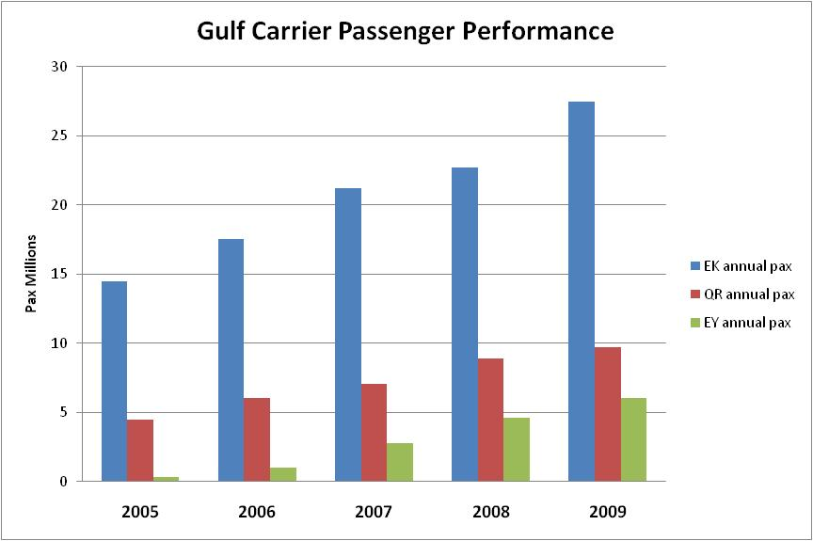
Airline Performance
All three Gulf carriers show major passenger growth.
Emirates has ten years head start over the other two.
The introduction of new fleet has added to its major growth in 2009.
Etihad has expanded rapidly; Qatar Airways expansion is steady.
17

Slide 18
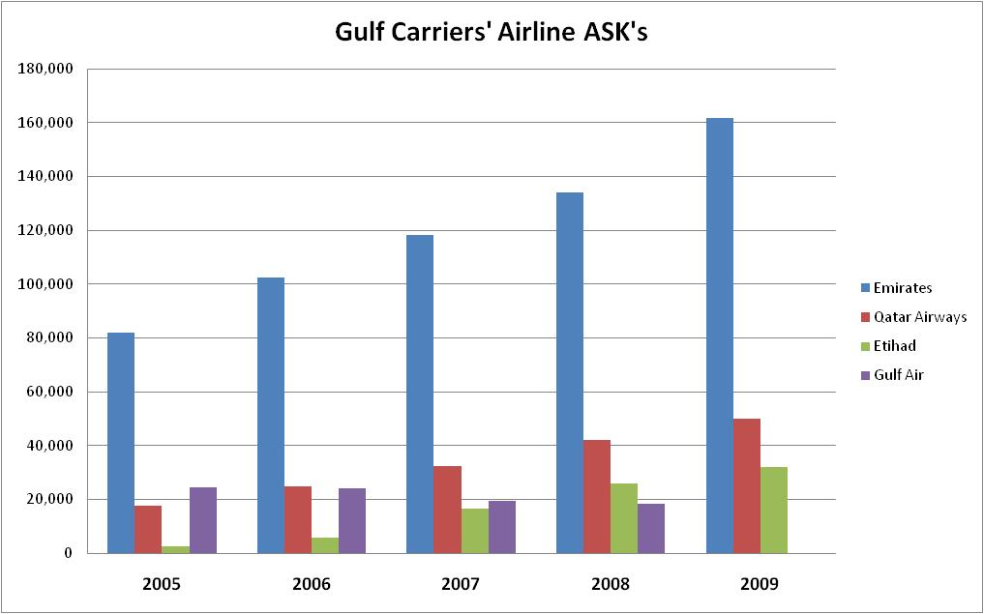
Airline Performance
The comparison with ASK’s is similar, with EK well ahead of its competitors.
As a further comparison, Gulf Air is included.
It is clearly financially distressed, with no expansion over the past four years.
There were no GF figures for 2009.
18

Slide 19
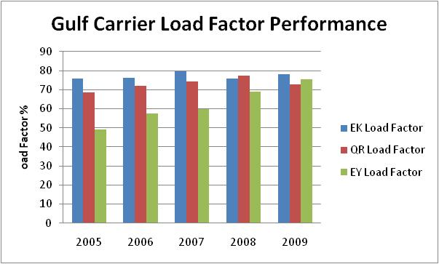
Airline Operating Performance
Over time, load factors have improved. EK’s load factor appears to have plateau-ed – probably due to the high levels of capacity added to their fleet.
Etihad load factor has rapidly expanded and is ahead of QR’s 2009 performance
(Souce;ATI)
19

Slide 20
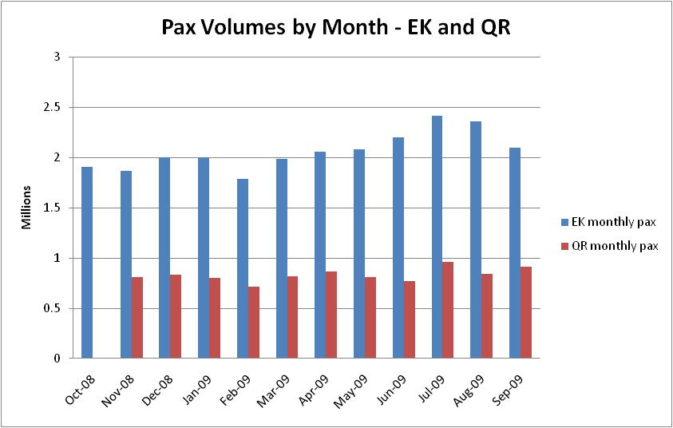
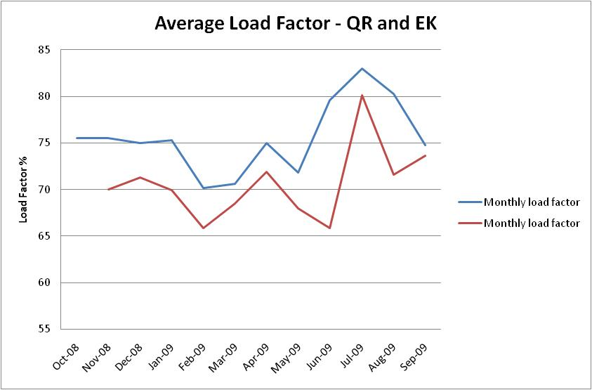
Airline Operating Performance
Seasonality does change during the Northern Hemisphere Summer months. It drops during February and March.
However, load factors are not extremely high, except for the summer months. Average load factors of around 75% are normal, system-wide. This is a function of the high capacity levels both airlines offer.
Etihad details were not available.
(Souce;ATI)
20

Slide 21
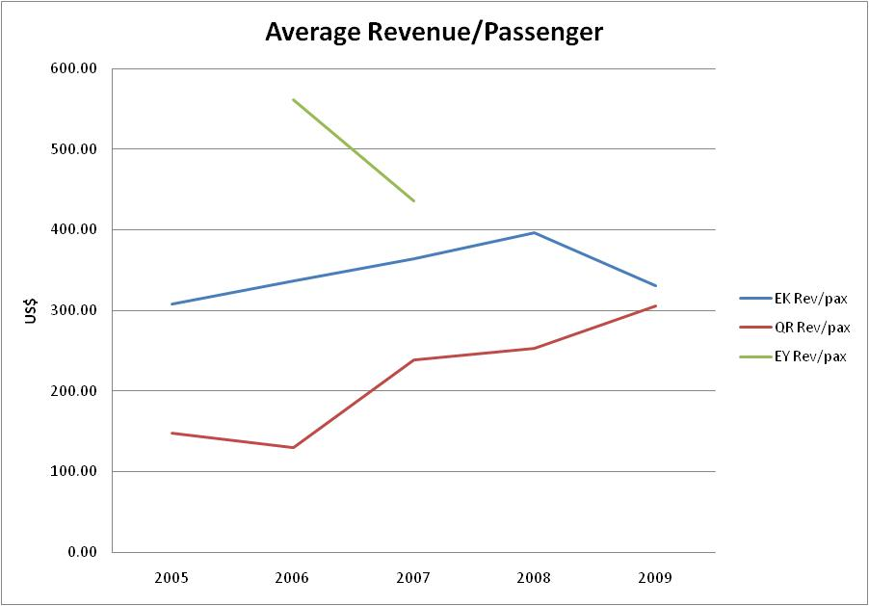
Aircraft Operating Economics
Qatar Airways’ average revenue per passenger continues to rise. Emirates’ revenues ell in 2009; a combination of the new capacity they added and the economic crisis that affected Dubai.
Etihad’s revenue figures are incomplete and cannot therefore be fully illustrated. However, in the short period of information it shows that they had the highest revenues/passenger.
(Data source: ATI)
21

Slide 22
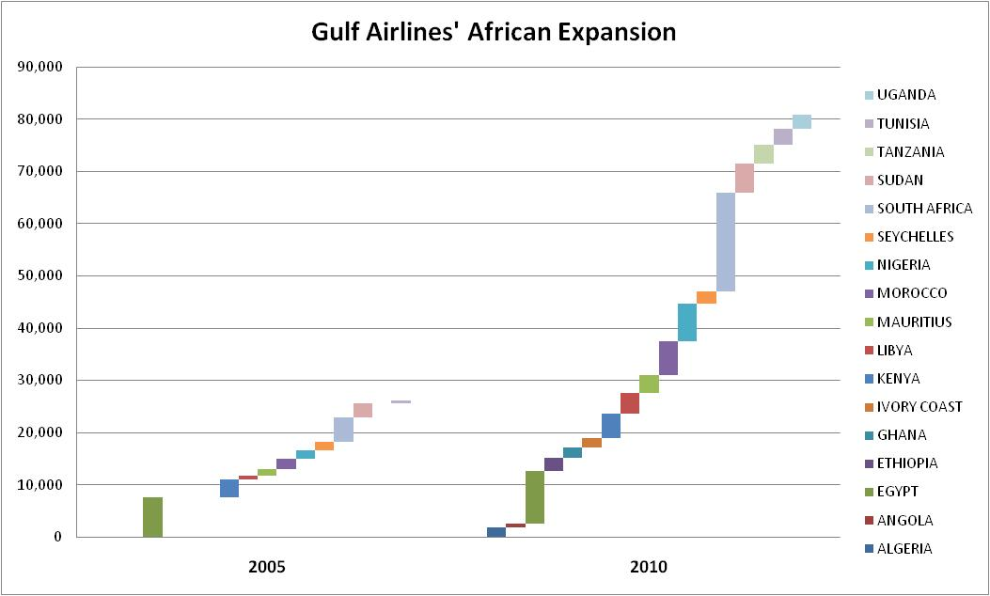
African Expansion by Gulf Carriers
Egypt has traditionally been the core African market for Gulf carriers. Rapid expansion by Gulf carriers in South Africa can be witnessed. Country markets has risen from ten to 17; most of it was sub-Saharan markets.
(Data source: FlightBase)
22

Slide 23
Route Development -
China and Gulf Carriers

Slide 24
Key Characteristics
Characteristic | Gulf Carrier | Chinese Airline
Expansion | Network-focussed | Core market focus
Directionality | Maximising network, two-way traffic | Generally one-way, main hub point-to-point traffic
Schedules | High frequency, regular timings | Low-frequency, market presence service
Market entry | Commercially/market-driven | Economically driven, country strategy priority
Operation | Non-stop wide-body | One-stop service
24

Slide 25
Key Characteristics
Route development and Chinese carriers:
They follow a Government agenda in Africa
They need a stopping point en route to Africa
They need to have a base load of ex--Chinese traffic to launch the service
They will operate low-frequency services
Political support can deliver success – use diplomats, trade missions and existing traffic providers
The airline is very hierarchical, you need to talk to people as high up as possible
Network planners need to have confidence that there is a market
Work out where your source market needs to originate (PEK, SHA, or CAN) – this will determine your target airline
Remember that you could dilute your existing carriers, such as the Gulf airlines
Make sure the air traffic rights exist
Check that the plane can make the journey fully-loaded with passenger and cargo loads
The process can be slow
25

Slide 26
Key Characteristics
Route development and Gulf carriers:
They are network-driven
They want feed to all parts of their network
They use their network for two-way traffic: in and out of the new market
They will not look at less than three/week services
Do not underestimate the importance of network planners in this segment
Pulling in political favours is less successful
They are very cost-focussed
They are hungry for connecting traffic as they add flights to their network
You need to offer traffic that outperforms their average performance
Can you offer traffic during the off-peak to support the network?
Understand your yields, competition and where you market is heading, ultimately
Which wave of the hub do you need to connect with?
Local managers and head office contacts are useful to securing the route
You must have enough traffic to beat the system average load factor (otherwise there is no point operating the route).
It will take three years from a zero start
26

Slide 27
Global Disclaimer
© 2010 ASM Limited. All rights reserved.
This material was prepared by ASM Ltd. Whilst based on information believed to be reliable, no guarantee is given that it is accurate or complete. The opinions, forecasts and assumptions contained in this material are as of the date indicated and are subject to change at any time without prior notice. The opinion referred to may not be suitable for any specific investment objectives, financial situation or individual needs of recipients and should not be relied upon in substitution for the exercise of independent judgement. Neither ASM Ltd nor other persons shall be liable for any direct, indirect, special, incidental, consequential, punitive or exemplary damages, including lost profits arising in any way from the information contained in this material.
This material is for the use of intended recipients only and the contents may not be reproduced, redistributed, or copied in whole or in part for any purpose without ASM Ltd’s prior express consent.
27

Slide 28
HOSTS
OFFICIAL CARRIER

